Slide 1
Federal Urdu University (Dept. of CS)
Dr. Kamran Ahsan
HCI (Human Compute Interaction)
Prototyping & Methods for
Navigation Design
Notes:
Non-verbal communication
CE00355-3 Advanced HCI & Usability

Slide 2
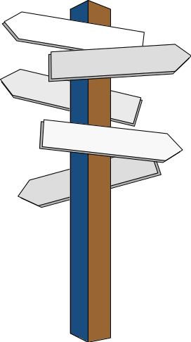
Introduction
In this lecture we will look at a range of issues to do with 1) understanding users’ needs through the use of prototyping &
2) supporting the development of users’ cognitive models, particularly through providing appropriate controls for application ‘navigation’
Notes:
Prototyping & Navigation Design
MSc2 HCI

Slide 3
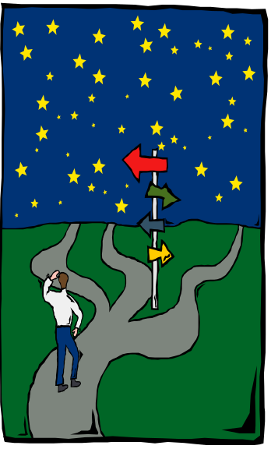
On ‘being lost’
Try and remember a time when you were lost. (How do you define ‘lost’ ?)
How did you feel ? - excited ?, or, more likely, maybe annoyed ?
What did you try to do ? - look around for signs / signposts …, ask a passing stranger for directions ?,
Were you under pressure to be somewhere, meet someone, do something ? How did this affect you ?
Did the behaviour of people around you, who appeared to know where they were, where they were going, and how to get there, affect you ?
In apparently ‘unstructured’ contexts a feeling of being ‘lost in hyperspace’ can be experienced, ironically users may even feel ‘trapped’ in a ‘loop’
of deja vue.
Yet the nature of many contemporary applications means they must support exploratory, ‘Browsing’ behaviours.

Slide 4

Stranger in a Strange Land
Usability of applications (a reminder) :
Does the user feel in control of the application ?
To what extent can the user achieve their goals using the application ?
How far does the product appear to assist the user ?
How easy is the application to learn ?
How does the user respond emotionally ?
Prototyping is an essential part of participatory design

Slide 5
The elements of an acceptable Design
Regard for Human Factors & capabilities e.g. Perception, Memory, the Use of Colour
A Layout and Structure that draw a User’s Attention to Task details - Navigation issues
(remember ‘effectiveness, efficiency, satisfaction’ , from the definition of Usability)
More complex navigation => more complex structure = > more complex application (for everyone involved)
Presentation of Content in a way suited to a User’s Performance of their Task (s)

Slide 6
Lo-Fi Prototypes
Usually paper mock-ups, so lower development costs
Focus on >development< of the main design elements and the overall design
Basic ‘proof-of-concept’
Appropriate for requirements gathering
Includes WOZ - Wizard of OZ approach for dialogue design
Produced quickly & so there’s less reluctance to have them as ‘throwaway’ prototypes
Widely used to generate a range of possible designs, which should ultimately result in a more satisfactory final product.
Bits can go missing, or can be easily damaged through handling.
The lack of detail can make them seem over-simplistic & ‘inadequate’
adding further detail can make them difficult to handle, especially if extra pieces are ‘stuck on.
Limited usefulness for usability tests – navigation etc restrictions

Slide 7
Hi-Fi Prototypes
Similar in look & feel to the final product
May be fully interactive
Useful for >evaluation< of the main design elements (content, structure, navigation etc)
Useful in confirming a final design – a ’living’ specification
Potential Sales tool
Relatively expensive to develop – both financially and in terms of time
(may need to acquire additional development resources, particularly
software tools)
Inappropriate for requirements acquisition because of product ‘stability’
May appear ‘too’ real, and disappointment can set in when the actual product takes a lot longer to deliver
Doesn’t ‘work’ as well or as efficiently with real data
Or in fact aspects which looked fine in the design cannot be implemented with available resources

Slide 8
Forming a ‘cognitive model’
All the elements of an application combine to help a user ‘construct’ their own mental (‘cognitive’) model, that can help them answer such questions as :
what do I think will happen when I select this , go there ?, and so on
Encouraging exploratory behaviours means having flexibility, predictability, supportiveness, robustness, as part of general Design Principles
Designers can use what users are already familiar with to reduce the learning effort

Slide 9
Ways of Finding your way around
Maps - 2D (but flat display ?) - topography, trails on floor (+ mark where you’ve been - change colour etc.), (SDGH ‘walking men’)
- 3D stairs, floors, layers (CAD) - use of colour
Hierarchies (preferably < 3 steps) & Tree Structures, Lists & Queues
Landmarks (Ebbinghaus’ walk to work), Signposts, Signage in general ‘Exit’,next, back, forward, up, down etc., Arrows, pointers
Compass points - N,S,W,E, stars, latitude, longitude, grid refs
Verbal or written instruction, directions, context-sensitive help
Keywords, ‘bubble help’, underlining, hyperlinks
Metaphors - familiarity
Kiosk, info desk, ‘reception’, doorways (‘Home’), environment
gallery, rooms, drawers, cupboards, other containers - things ‘inside’
Front / back cover (start,end), titles, headings, indexes, page numbers, page corners, ‘thick’ or ‘thin’ pages, sections, sub-sections
Interface Agent guides - Einstein, ‘Clip’
Animation e.g. moving lights ‘from’ ‘to’

Slide 10


User navigation ‘types’
There are many perceived types of user :
Browsers - Can be focused or unfocused
Planners - Think before starting a practical task
Searchers - Are focused, aiming for a particular target
Explorers - Use a concentrated form of scanning, user looks at the nature and content of information
Wanderers - May go around in circles on several occasions
Fearful users - Are not confident in using the machine
Fun-seekers - Only look for the interesting bits, e.g. animations or videos (not interested in content)
It is of course acceptable to place a single user in several
of these categories, and people will change their
behaviours between one application to another

Slide 11
Navigation and user issues
Emphasis on the user finding the ‘correct’ pathway, given freedom to explore
Users need to perceive this and build up enough ‘intrinsic motivation’ & skill to cope with :
- how to tackle a topic, how long to spend on it, detail to go into, quantity of information to view etc.
People often do not understand the ‘holistics’ of the situation, i.e. the larger picture of how the information in an application fits together - they were not the designers, so why should they ?
Users typically have to overcome the software interface first before acquiring the actual information
This must be a quick process to maintain interest.

Slide 12
Including maps
Incorporate maps to avoid the ‘hyper-space’ problem of being lost in the information (content) space provided
The map provided should show : present position ‘you are here’, where you have been ‘deja vue’ and what’s left to see (to give scope for user exploration)
A hierarchical example :
(see also :
Star or Hyperbolic Tree
Tree structures
Semantic & Transition
Networks etc.)

Slide 13
Navigation and Interaction
All controls used should appear in ‘logical’ positions
- Reduces search times on the users part
Always try and keep to conventions (see other good designs, guidelines etc. ) where these exist
A designer can broadly take one of two navigation design approaches:
Informational systems which are ‘explicit’
Metaphor applications which are ‘implicit’
The design approach will also be coupled to either a ‘Passive’ or ‘Highly Interactive’ application design

Slide 14
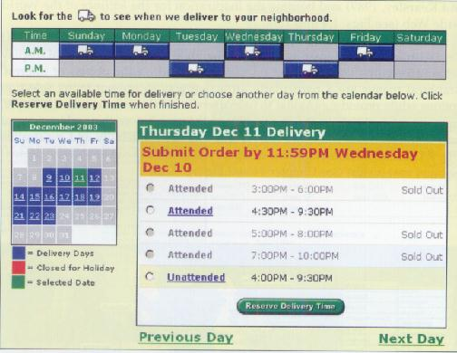
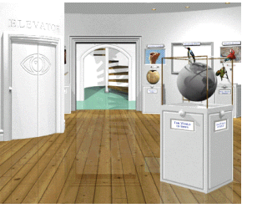
Explicit & Implicit
Explicit systems
- Plain but all interaction is directly viewable
Implicit (metaphor) systems
- Advanced to look at, but all navigation and
interaction needs to be ‘hunted’ out by the user

Slide 15
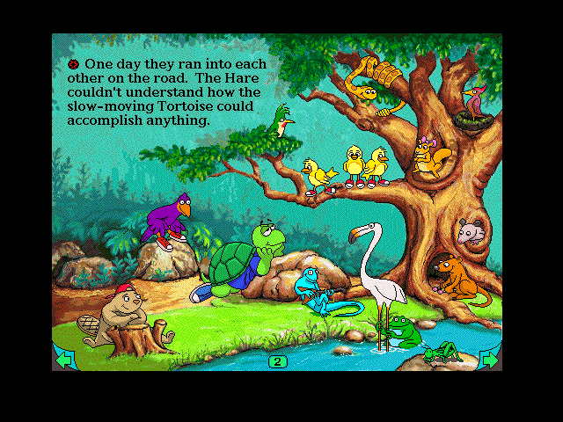
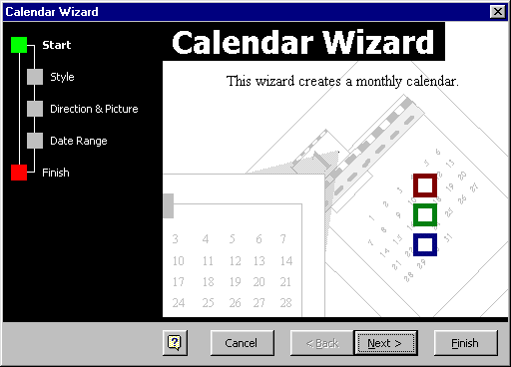
‘Passive’ applications
Emphasis on simple linear progression
e.g. forward and back (book-page structure)
Press to move on, low cognitive load, little can go wrong
Mainly sit back and watch auto- running on page load (little interaction)
or MS ‘wizards’ (highly constrained interaction)

Slide 16
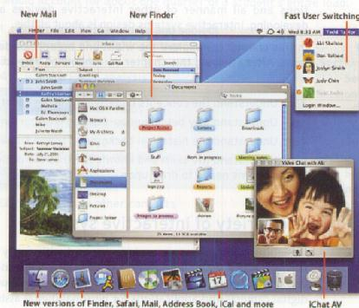
Highly interactive applications
Non-linear exploration (example from Mac OS X.2)
Diversity of actions on users part, user has to work. Interaction diversity leads to higher cognitive overhead
Needs clear, selectable options

Slide 17
A Sample of Navigation Devices
Navigation maps - Particularly important for multimedia and websites
Xerox inxight has a range of tools e.g. ‘Star’ (hyperbolic) tree, example at :
http://www.inxight.com/Demos/SLS_Demos/Site_Lens_Studio_Demos.html#

Slide 18
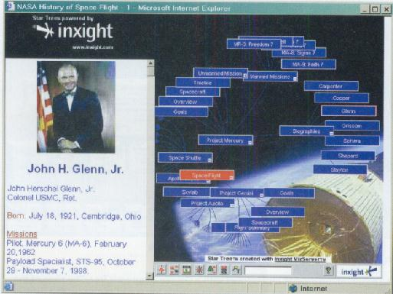
Hyperbolic Tree

Slide 19
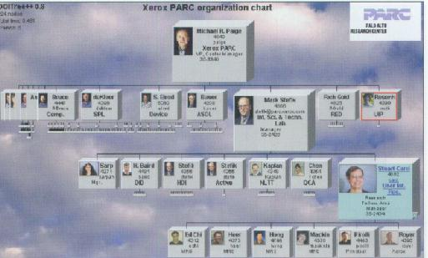
Degree-of-Interest Tree

Slide 20
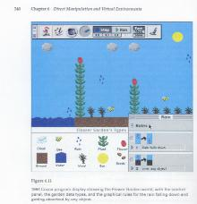
Metaphor 1 - Environment

Slide 21
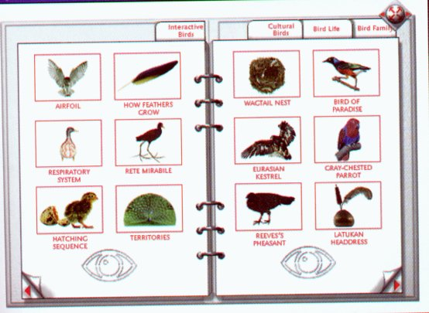
Metaphor 2 - Book-page

Slide 22
Summary
A good application will provide :
Appropriate structure and navigation to aid in gaining knowledge from fragments that together make a coherent whole, yet are themselves individually meaningful
Freedom of access - browsing
Easy access to an area of interest - focus
Cross-referencing
Backtracking (as in Undo) to support exploratory behaviour, and to recover from an irrelevant pathway /route
Text search facilities to bypass browsing navigation (in support of efficiency)
With any prototype it’s wise to take a series of ‘snapshots’ of the designs emerging from the use of the prototype with annotations of why design changes were made, in support of a design rationale.

Slide 23
Prototyping early in Design
Advantages –
gaining feedback from users at a time when it’s still reasonable to make design modifications;
develops users’ sense of involvement in the development process;
can introduce key features of the possible end product to the users and hence enhance familiarity, (with knock-on effects on training / support);
it may be possible to iterate through to a final end product.
Disadvantages –
can make users feel uneasy about the ‘quality’ of the final design in terms of functionality or usability or both;
requirements creep;
‘thrashing’ between alternative designs & a reluctance to keep throwing away a product that’s ‘nearly’ there.

Slide 24
References & Further Reading
Benyon D et al (2005) Designing Interactive Systems
Harlow, Essex : Addison Wesley
Lauesen S (2005) User Interface Design - a Software Engineering Perspective
Harlow, Essex : Addison Wesley (pp 58 - 63 provided)
Shneiderman, B et al (2005) Designing the User Interface : Strategies for Effective Human-Computer Interaction (3e) Reading MA: Addison-Wesley
(& the companion website at www.aw-bc.com/DTUI )

